Slide 1
Question Paper Generator
Presented by,
Anannya Nirmalan
Chithu K
Vani M
Notes:
ID=d924773e-9a16-4d6d-9803-8cb819e99682 Recipe=text_billboard Type=TextOnly Variant=0 FamilyID=AccentBoxWalbaum_Zero

Slide 2
Introduction
Many examinations, from the internal tests to the main examinations, takes place in one academic year. Teachers has to devote a lot to create different question papers for all of these exams.
Automating the process of generating unique question papers based on the questions provided by the teachers will help solving the said problem efficiently by saving time and effort.
The web-based application will provide teachers a portal to upload the questions
The application will shuffle the questions from each section and provide a question paper for each student attending the exams.
The question papers can be accessed by the teachers in a pdf format from the portal itself.

Slide 3
Problem Statement
The aim of the project is to provide a portal for a set of teachers to enter the questions and automatically generate a question paper.
The system shuffles questions provided by different teachers.
Admin will be able to generate the template that determines the format of the question paper to be generated

Slide 4
Module Description
There are only two users in the system. They are;
Admin
The admin will be able to register faculties into the system to ensure security
The admin will be able to add courses in each semester
The admin will be able to select the template of the question paper
The admin will be able to initialize the shuffling of the question with the help of a button
The admin will be able to analyse and compare the questions manually as well to ensure integrity

Slide 5
Module Description(Cont.)
2. Teachers
The faculty will be able to select subjects from the subject catalogue.
The faculty will be able to enter the questions into the portal through a user friendly webpage.
The faculty will be able to delete the questions stored in the database corresponding to their course.

Slide 6
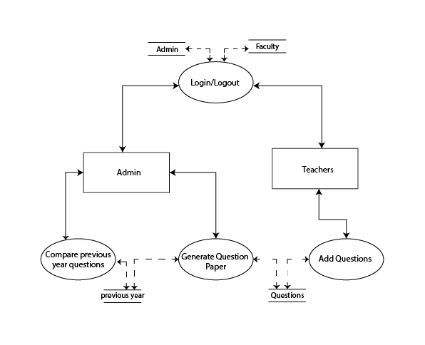
Architecture

Slide 7
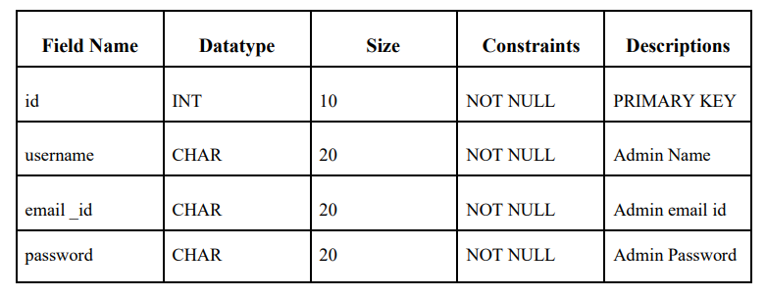
Table Design
Table Name: Admin Table
Table Descriptions: To store the login details of the Admin

Slide 8
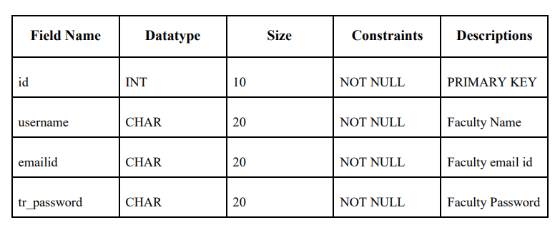
Table Design
2. Table Name: Faculty Table
Table Descriptions: To store the login details of the Faculty

Slide 9
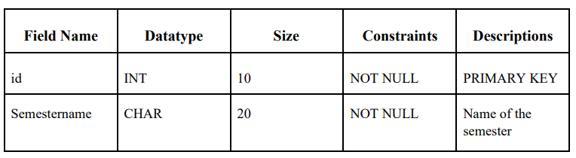
Table Design
3. Table Name: Semester Table
Table Descriptions: To store the details of the semesters.

Slide 10
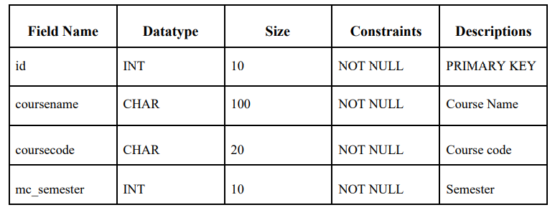
Table Design
4. Table Name: Adding Course Table
Table Descriptions: To store the details of the courses.

Slide 11
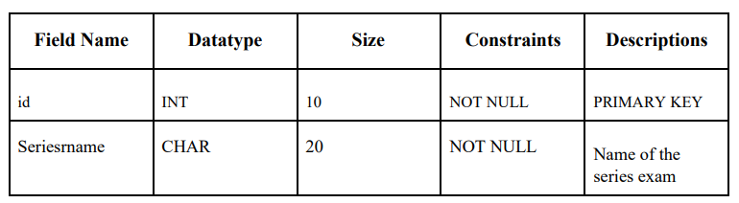
Table Design
5. Table Name: Series Table
Table Descriptions: To store the details of the series.

Slide 12
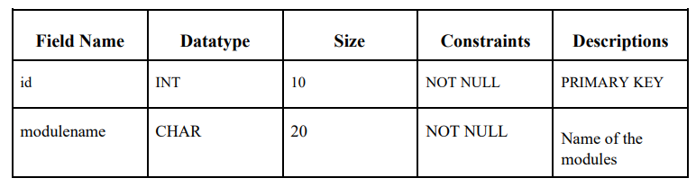
Table Design
6. Table Name: Modules Table
Table Descriptions: To store the details of the Modules

Slide 13
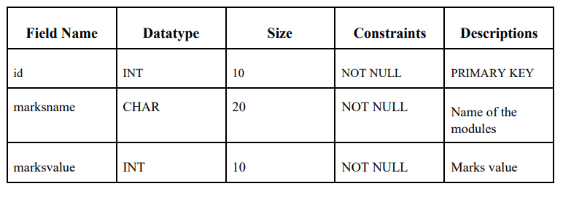
Table Design
7. Table Name: Marks Table
Table Descriptions: To store the details of the Marks.

Slide 14
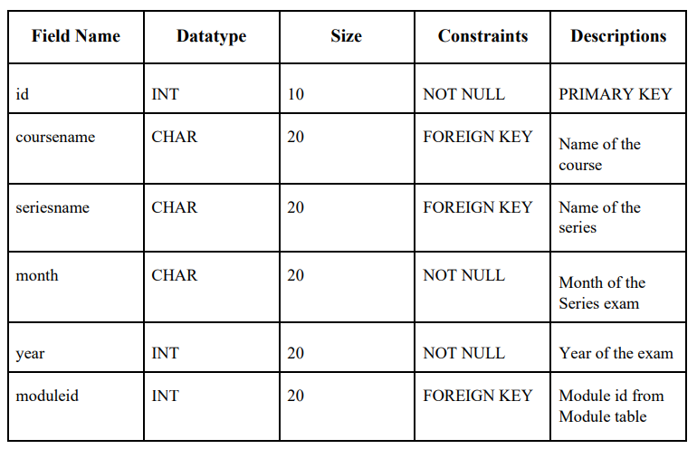
Table Design
8. Table Name: SelectedCoursetoGenerate Table
Table Descriptions: To store the details of the selected course and modules.

Slide 15
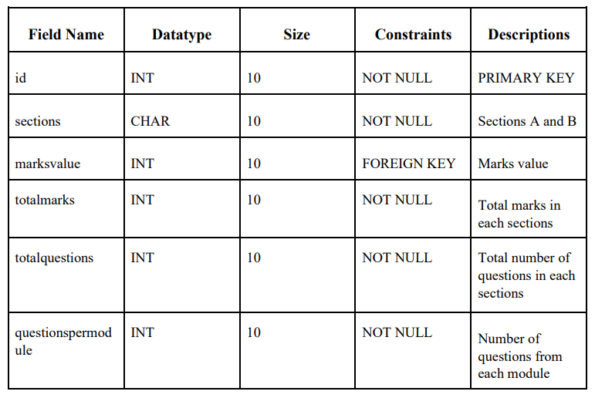
Table Design
9. Table Name: Template Table
Table Descriptions: To store the details of the template that determines the format of the question paper to be generated.

Slide 16
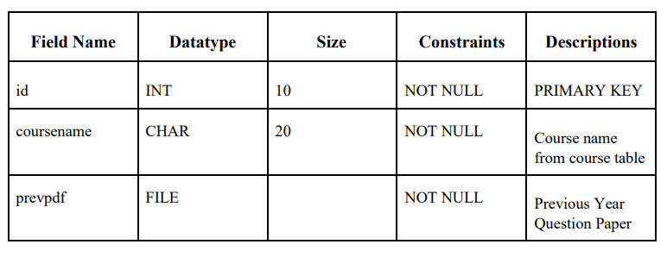
Table Design
10. Table Name: PrevPDF Table
Table Descriptions: To store the previous year question papers used for comparison.

Slide 17
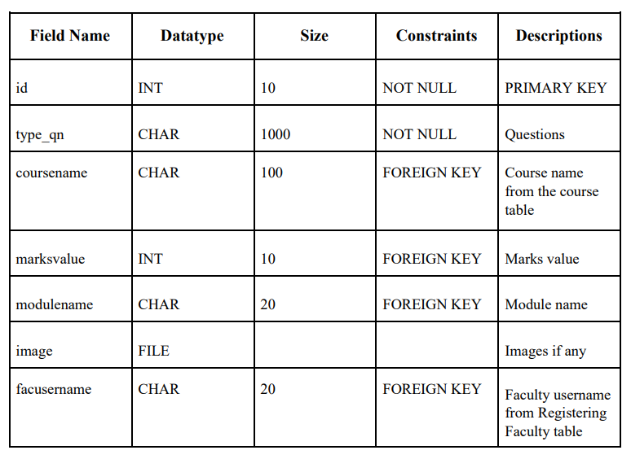
Table Design
11. Table Name: : AddQn Table
Table Descriptions: To store the details of the questions.

Slide 18
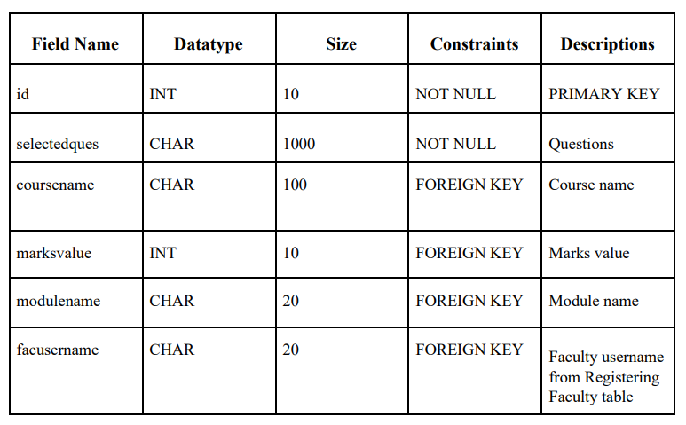
Table Design
12. Table Name: FinalQuestions Table
Table Descriptions: To store the details of the selected questions.

Slide 19
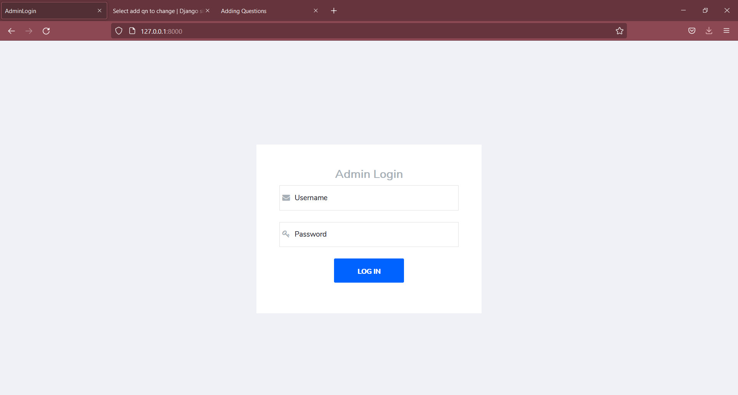
Admin Login

Slide 20
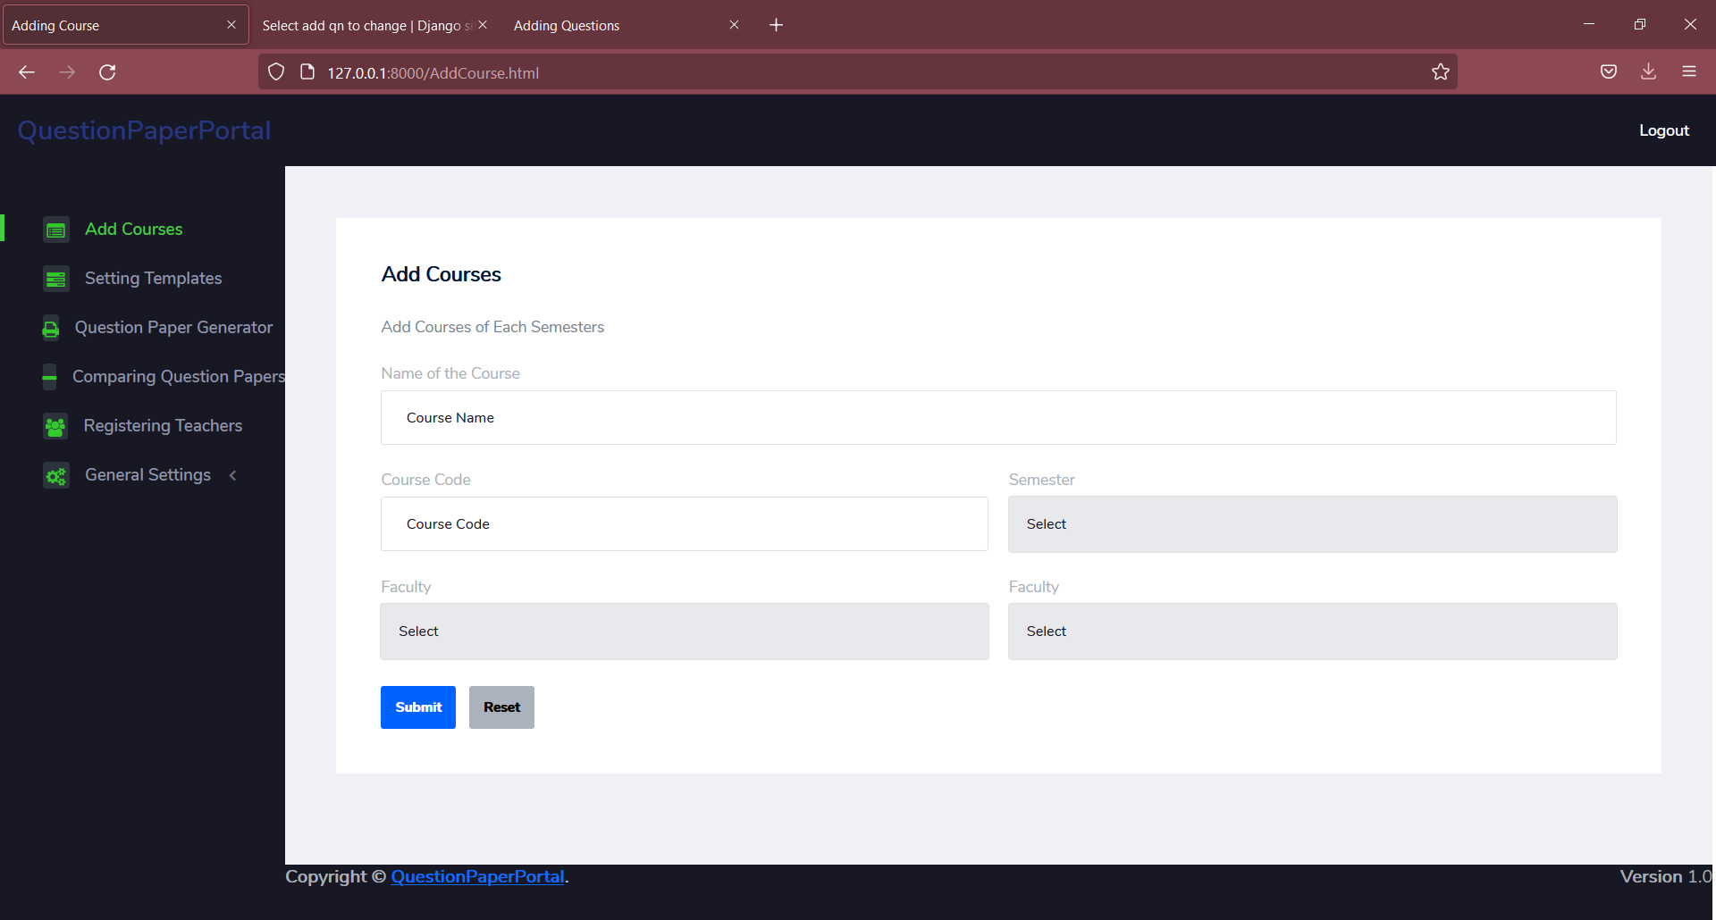
Adding Courses

Slide 21
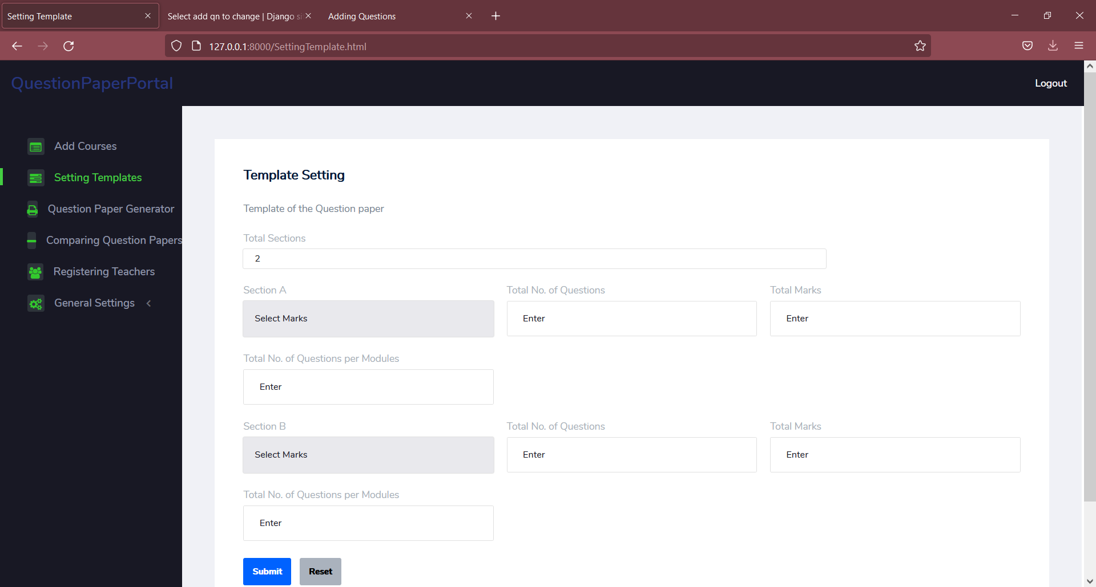
Setting Template

Slide 22
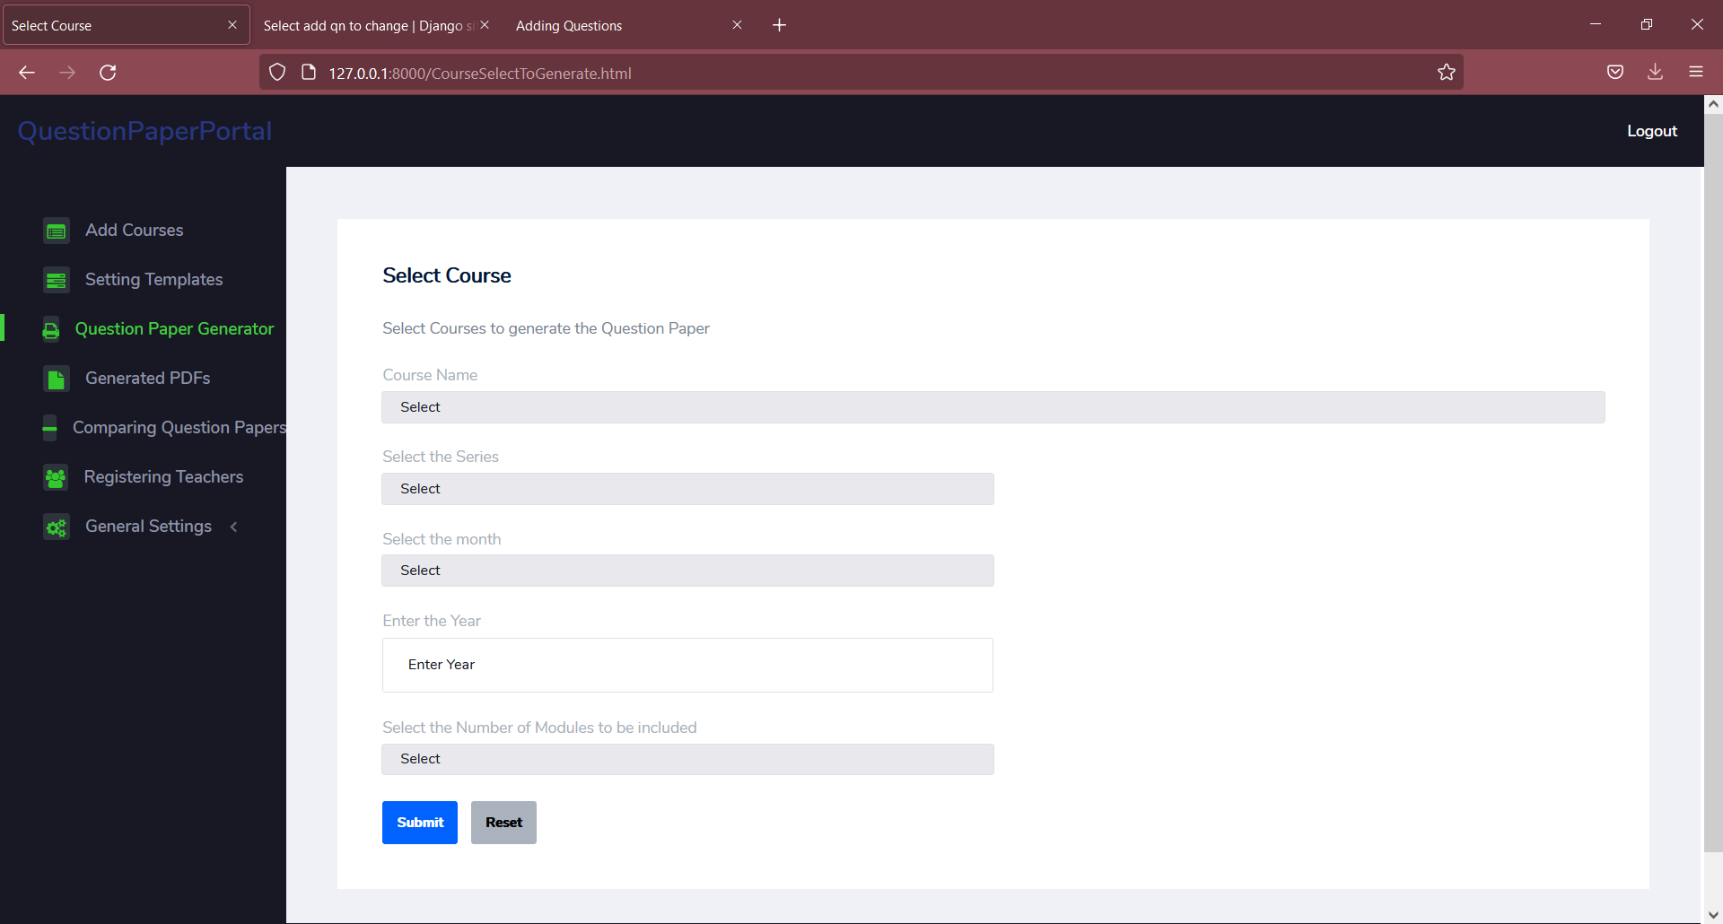
Question Paper Generator

Slide 23
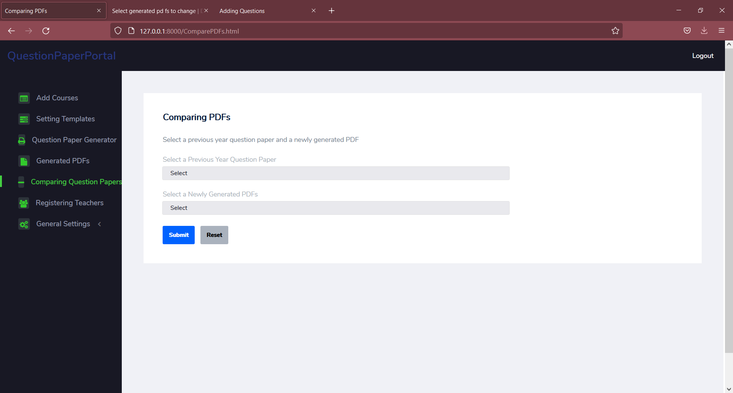
Compare PDF

Slide 24
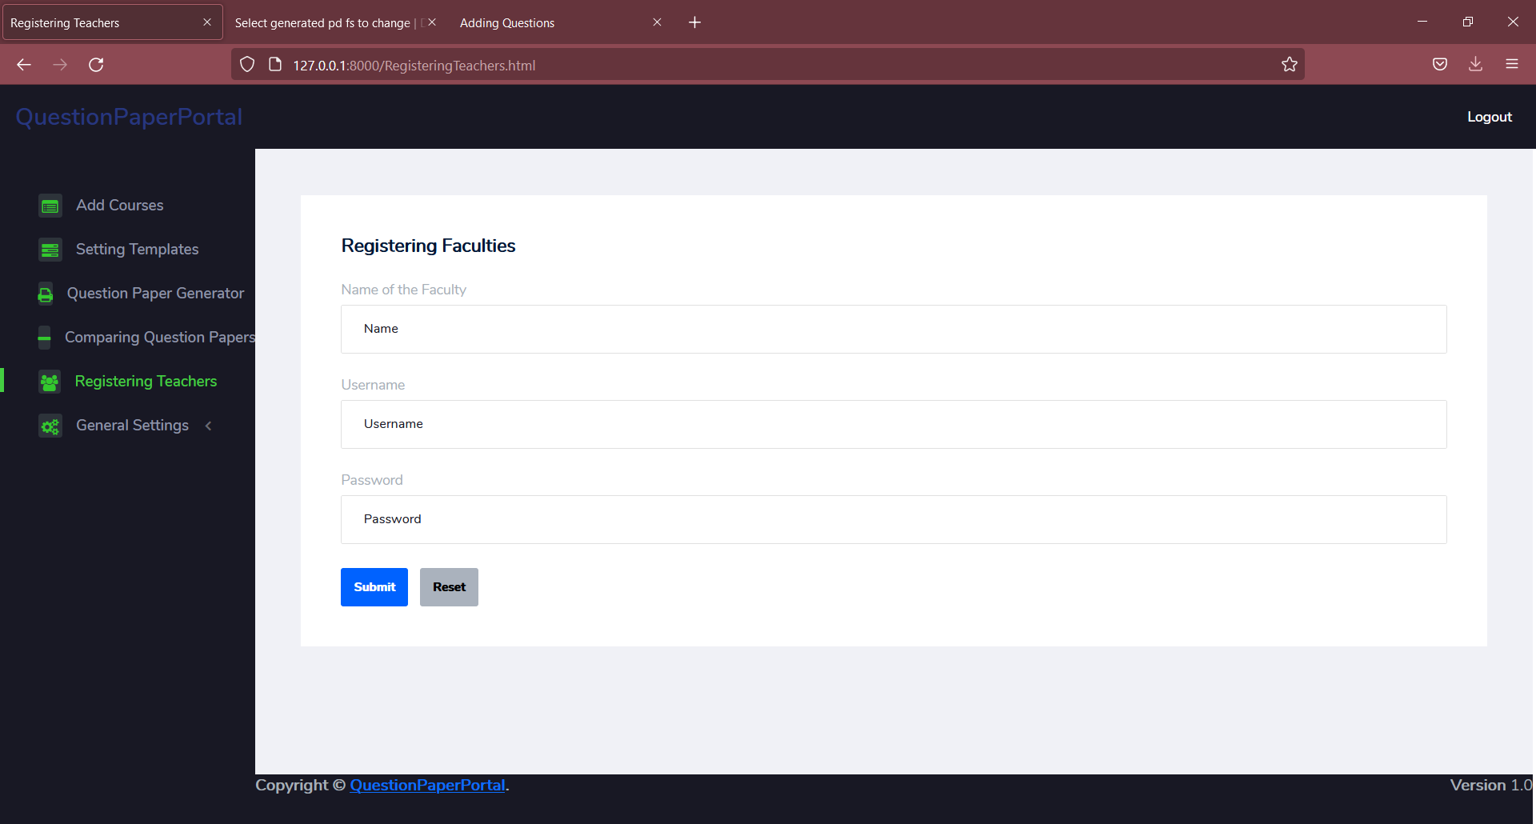
Registering Faculties

Slide 25
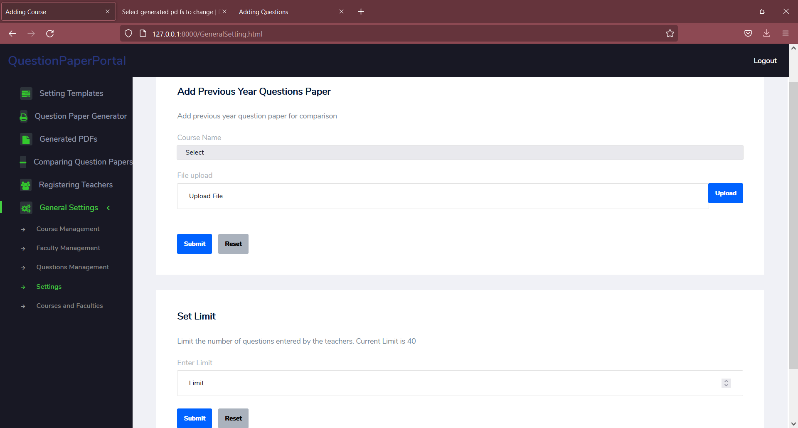
Settings

Slide 26
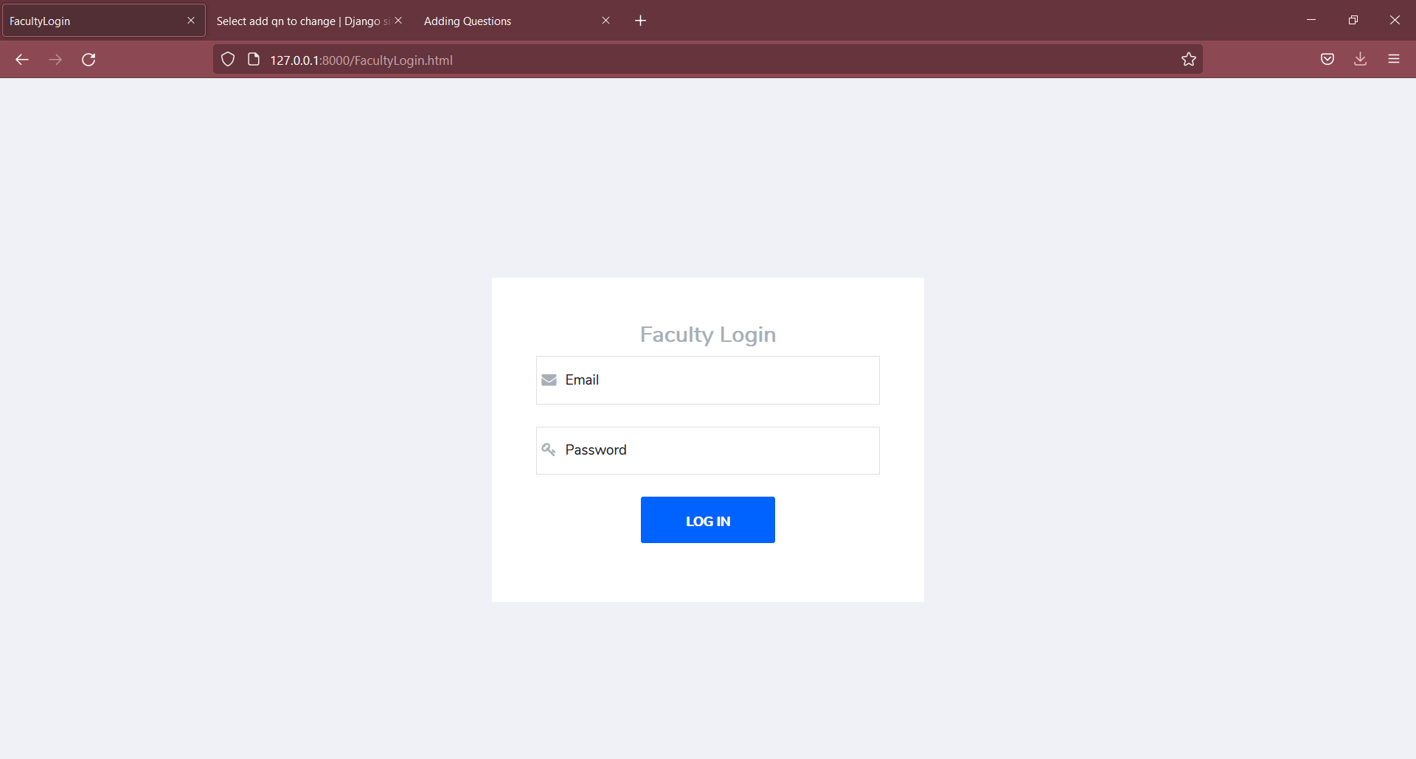
Faculty Login

Slide 27
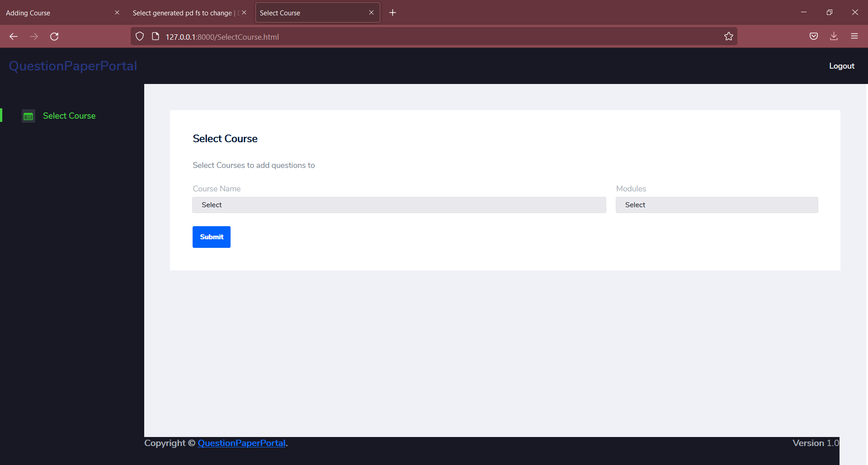
Select Courses

Slide 28
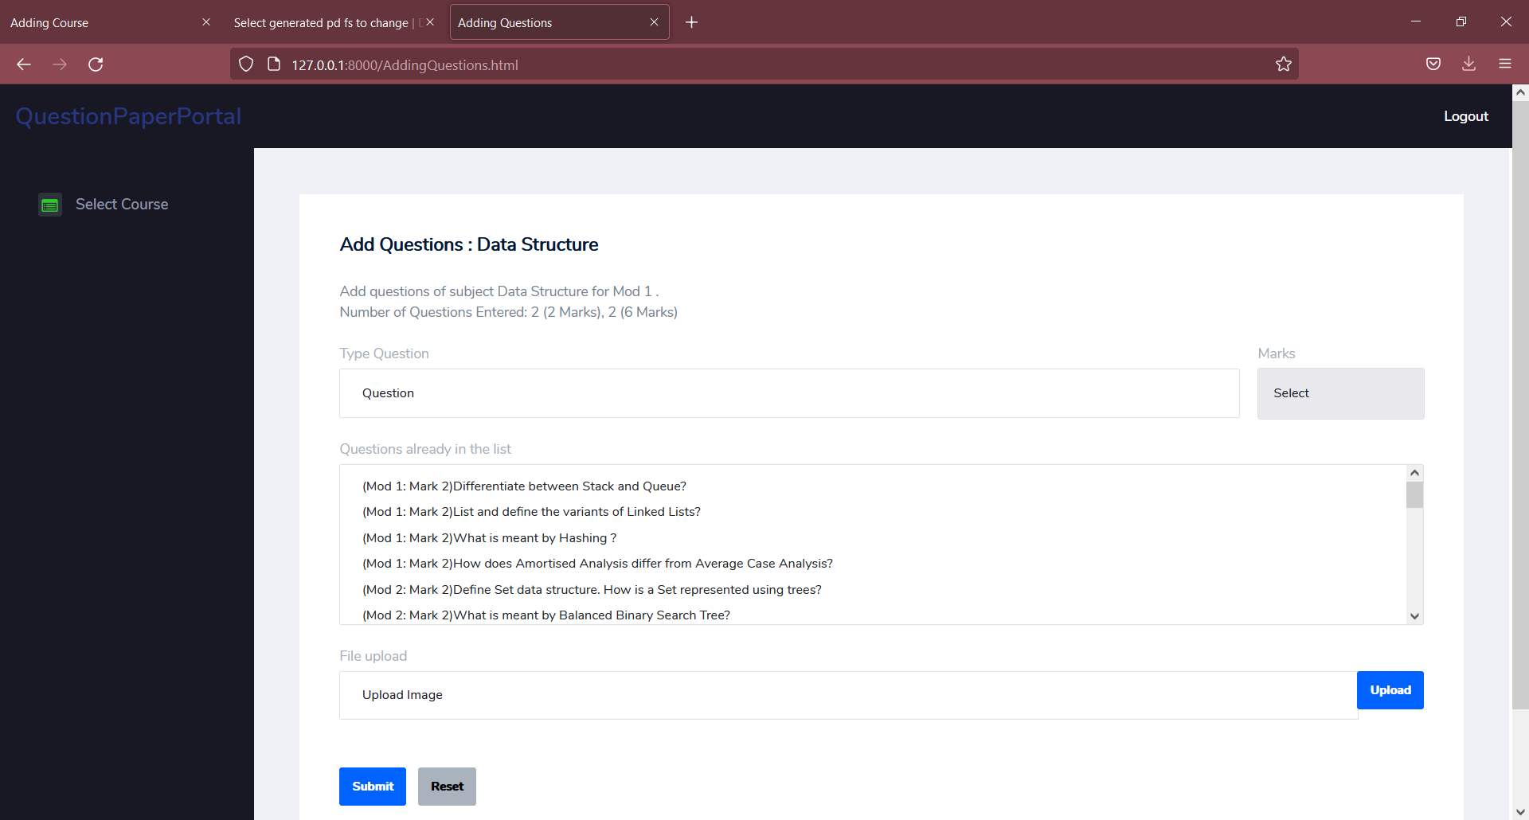
Adding Questions

Slide 29
Conclusion
So this web portal provides a platform for the faculty to customize the question paper in the format as they needed and automating the process of generating unique question papers based on the questions provided by the faculty.

Slide 30
Thank You
Notes:
ID=d924773e-9a16-4d6d-9803-8cb819e99682 Recipe=text_billboard Type=TextOnly Variant=0 FamilyID=AccentBoxWalbaum_Zero

